Slide 1

Hackathon #1 : Business Plan
Digital Platform Economy
hackathon 2018
Team #Number: Team Name

Slide 2

What are the pain points in the market?
What do you offer? And how it is solve the market plan?
Identify all the critical parties in a multi-sided platform
Analyze where value creation and exchange takes place among different customers, and with the platform business itself
Pain Points & Business Model

Slide 3
Users’ needs
What are their pain points or their needs? How can the platform help them?
Customers | Pain Points | Needs
Freelancers | Hard to find jobs Do not have jobs consistently Do not get payment after solution delivery xxx
xx
xx
xx

Slide 4
Platform Business Model Analysis
Customers | Value received from other customers - $ in bold | Value received from platform - $ in bold | Value provided to other customers - $ in bold | Value provided to platform - $ in bold | Customers they attract | Profile
xx
xx
xx
xx

Slide 5

Business Model Map
xxx
xxx
xxx
xxx
xxx

Slide 6

To be successful in platform economy, it is crucial to ramp up users from both sides – customers and freelancers in the first 6-12 months.
What strategy would help to increase the engagement of freelancers and business owners in the initial stage?
And how to maintain them?
Go-to-Market Strategy

Slide 7
Go-to-Market Strategy (1)
How to reach and recruit users?
Who? | What activities or campaigns? How? Where? | Why select this?
Business Owner | Advisement in business expo
Freelancers | Recruitment booth at campus’ job fair

Slide 8

Which type of revenue model will you recommend?
What to charge?
How to charge? How much?
Who to charge?
When to collect?
AND Why you recommend this revenue model? Do you think the payer will pay for it?
Consider different products, different membership types, and so on.
Revenue Model

Slide 9
Revenue Model
How do we gain revenue?
Types of revenue | Who to charge? | When to charge? | Explain why? [Why do you choose this? Why would they will pay?]
Matching Fee | Business owner | After project confirmation | Matching fee is counted towards services supplied by Star cruise platform
xx
xx
xx
xx
xx
xx
xx

Slide 10
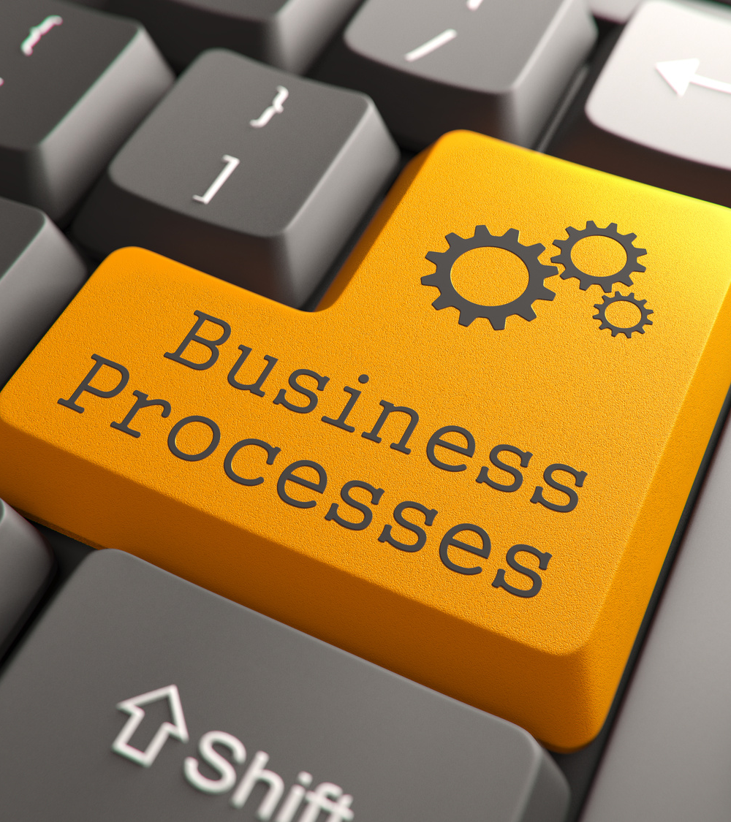
Explain your business model thoroughly and demonstrate how Star Cruise should operate its business.
The fundamental of this platform economy would include the following processes:
Registration & Profile Verification
Job Matching | Multiple-party Job Matching
Delivery Process | Quality Assurance | Payment
* Suggest other add-value process or features to the platform that can help strengthen your business model
Key Business Processes

Slide 11
#1 Registration & profile verification
6.xxx
1. Title
2. xxx
3.xxx
4.xxx
5.xxx
xxx
xxx
xxx
Characteristics
Actions
Features
xxx
xxx
xxx
xxx
xxx
xxx
xxx
xxx
xxx
xxx
xxx
xxx
7.xxx
xxx
xxx
xxx
8.xxx
xxx
xxx
xxx
12. xxx
11. xxx
10.xxx
8.xxx
9.xxx
xxx
xxx
xxx
xxx
xxx
xxx
xxx
xxx
xxx
xxx
xxx
xxx
xxx
xxx
xxx
Which types of users?
Which types of products?

Slide 12
#2 Job Matching | Multiple-party Job
6.xxx
1. xxx
2. xxx
3.xxx
4.xxx
5.xxx
xxx
xxx
xxx
xxx
xxx
xxx
xxx
xxx
xxx
xxx
xxx
xxx
xxx
xxx
xxx
xxx
xxx
xxx
7.xxx
xxx
xxx
xxx
8.xxx
xxx
xxx
xxx
12. xxx
11. xxx
10.xxx
8.xxx
9.xxx
xxx
xxx
xxx
xxx
xxx
xxx
xxx
xxx
xxx
xxx
xxx
xxx
xxx
xxx
xxx
Which types of users?
Which types of products?

Slide 13
#3 Delivery Process | Quality Assurance | Payment
6.xxx
1. xxx
2. xxx
3.xxx
4.xxx
5.xxx
xxx
xxx
xxx
xxx
xxx
xxx
xxx
xxx
xxx
xxx
xxx
xxx
xxx
xxx
xxx
xxx
xxx
xxx
7.xxx
xxx
xxx
xxx
8.xxx
xxx
xxx
xxx
12. xxx
11. xxx
10.xxx
8.xxx
9.xxx
xxx
xxx
xxx
xxx
xxx
xxx
xxx
xxx
xxx
xxx
xxx
xxx
xxx
xxx
xxx
Which types of users?
Which types of products?

